Slide 1
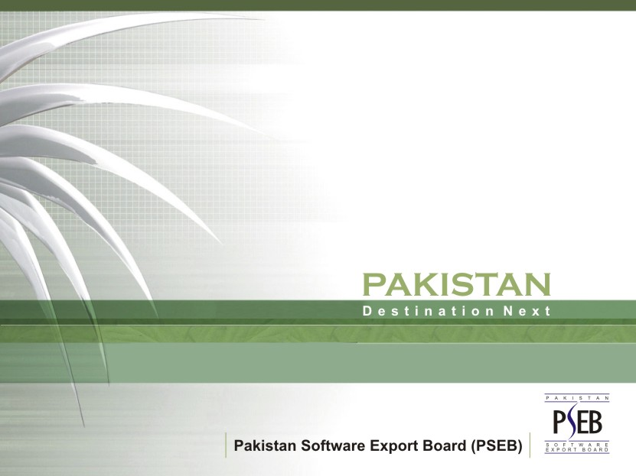

Slide 2

OVERVIEW | Fundamentals in place

Slide 3
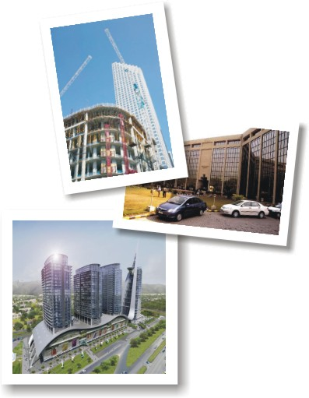
SPACE | Changing Skylines
42 Projects
700 Acres Islamabad IT City
400 Acres Karachi Media City
50 Acres Islamabad IT Park
2000 Acres Biosphere Tech City
Karachi & Lahore Airport IT Parks
An ambitious program of world-class IT Parks, with a rent rate of under US$ 1.5 per sq ft/month
Source: PSEB, 2007

Slide 4

HUMAN CAPITAL | Prioritizing Human Development
Higher Education Commission (HEC) transforming higher education
Large pool of English speaking human capital (approximately 6.5 million)
423,000 Plus annual English speaking enrolled
under graduates and graduates
Major plan to build nine state of the art universities
27 different HEC PhD Programs
118 HEC Recognized Universities
PSEB Programs
Soft skill
Internship
Apprenticeship
Professional
Training
Source: HEC, 2007, SCIDEV.NET 2007

Slide 5
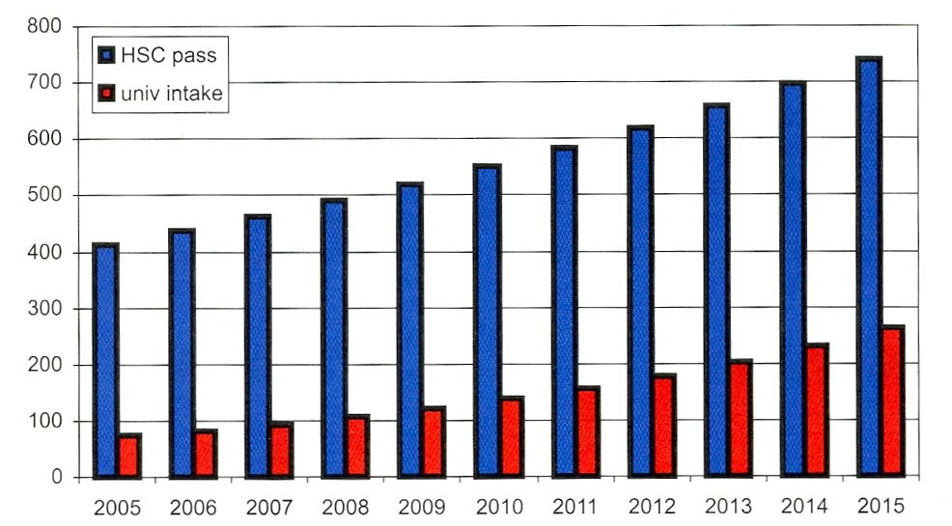
HUMAN CAPITAL | Prioritizing Human Capital
Rs. Millions
20000
18000
16000
14000
12000
10000
8000
6000
4000
2000
0
2001/02
2002/03
2003/04
2004/05
2005/06
Spending Indicator
Public Higher Education Institution Revenues, 2001/02 – 2005/06
HSC Graduates and University Intake, 2005-2015
Source: Pakistan: An Assessment of the Medium Term Development Framework, The World Bank, 2006

Slide 6
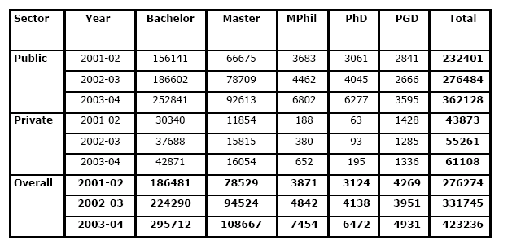
HUMAN CAPITAL | Prioritizing Human Capital
No. of students enrolled by Sector and Level of Degree over the years
Source: HEC Annual Report 2004-2005

Slide 7
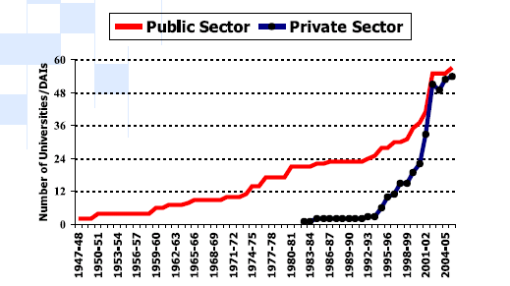
HUMAN CAPITAL | Prioritizing Human Capital
No. of Universities in Public and Private Sector since 1947-48 to 2004-05
Source: HEC annual report 04-05

Slide 8
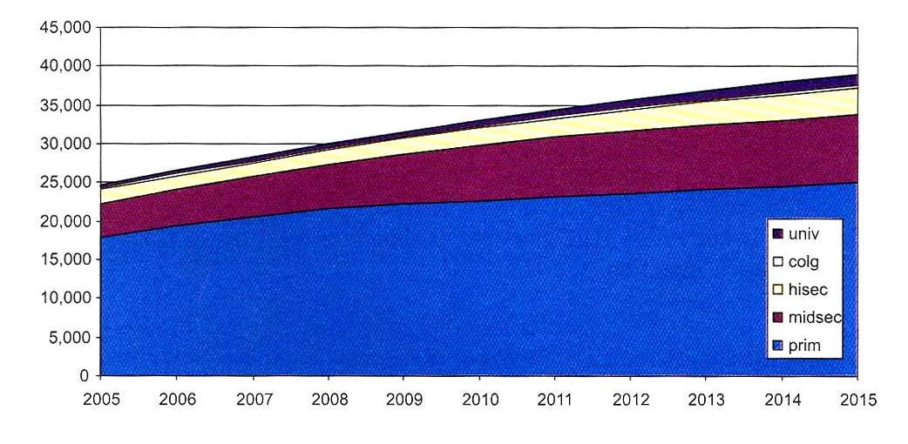
HUMAN CAPITAL | Prioritizing Human Capital
Enrollment Projections 2005-2015 (000s)
Source: Pakistan: An Assessment of the Medium Term Development Framework, The World Bank, 2006

Slide 9

POLITICAL STABILITY | National consensus on modern society & global economic integration
Privatization & deregulation policies pursued since over two decades
by successive Governments
Active Parliament
Independent Judiciary
Free Media
Grass roots level local Government
Regular Elections

Slide 10

LAW & ORDER | Reality different from perception
The crime rate in Pakistan is low compared to industrialized countries.
The rate of total index offenses decreased from 81.89 to 48.07 per 10,000 – a decrease of 41.3%
Pakistan is promoting its vision of enlightened moderation throughout Islamic world
Pak-India relations transformed in the last 6 months and peace dividends expected
Quantum improvement in half century old Pakistan–US relations since 9/11
Source: BMA Capital, 2007, Comparative Criminology of the World, Dr. Robert Winslow, San Diego State University, 2006

Slide 11
COUNTRY RISK| Better Risk Profile than most nations
Risk perceptions misaligned with reality
S&P Rating
Moodys Rating
9.0
4.5
Ba3
Ba3
8.0
B
4.0
7.0
B+
B-
B+
3.5
B2
6.0
3.0
B2
5.0
B-
2.5
B3
4.0
CCC
2.0
3.0
CCC-
1.5
B3
2.0
CC
Caa1
SD
1.0
1.0
0.5
-
0.0
Nov-94
Nov-96
Nov-98
Nov-00
Nov-02
Nov-04
Nov-94
Jul-96
Mar-98
Nov-99
Jul-01
Mar-03
Nov-04
Source: Bloomberg
Source: Bloomberg
Risk ratings have made a full recovery following period of heightened risk 97-99
Re-ratings are expected to continue given favourable economic outlook
Source: BMA Capital, 2007

Slide 12
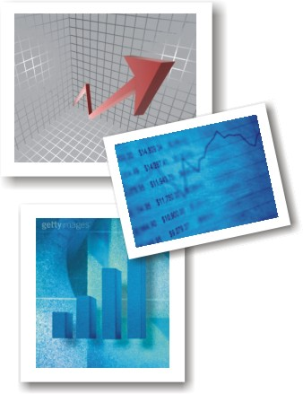
ECONOMY | Tiger Economy
Economic growth has accelerated to 7%YoY average over FY03-06
  Robust consumer spending, rising investment and accelerating exports creating sustainable growth
  Emerging middle class and favorable demographics
  Improved sovereign risk ratings
  One of the fastest growing economies in the world
Doubling of GDP between 1999 and 2006
Graduation to Middle Income Country
8.4% growth in 2005 was 2nd highest in the world
7% growth in 2006
Over 1000% growth in Foreign Direct Investment
Multi-billion dollar real estate investments by leading international developers
  Tremendous investments and growth in Telecom, IT, Real Estate, Electronic Media, Oil & Gas, Automobiles, Manufacturing and Finance
  Over 400% growth in remittances from expatriates abroad from USD 1 billion in 1999 to USD 4 billion in 2005
Source: Economic Survey 2005-2006

Slide 13
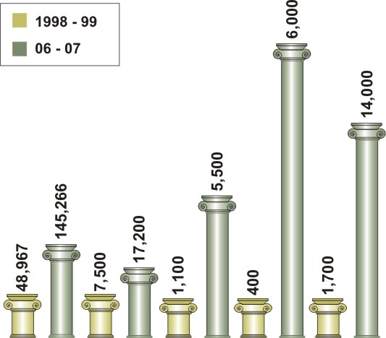
ECONOMY | Tiger Economy
Economic Prosperity
GDP
(Million $.)
Exports
(Million $.)
Remittances
(Million $.)
FDI
(Million $.)
Foreign Exchange
Reserves (Million $.)
Source: Ministry of Finance, 2007

Slide 14
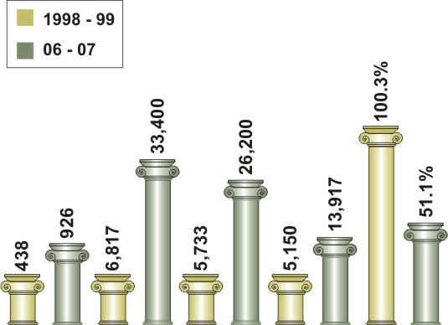
ECONOMY | Tiger Economy
Economic Prosperity
Per Capita
Income ($)
Investment
(Million $.)
National Savings
(Million $.)
Revenue Collection
(Million $.)
Total Debt
(Percent of GDP)
Source: Ministry of Finance, 2007

Slide 15
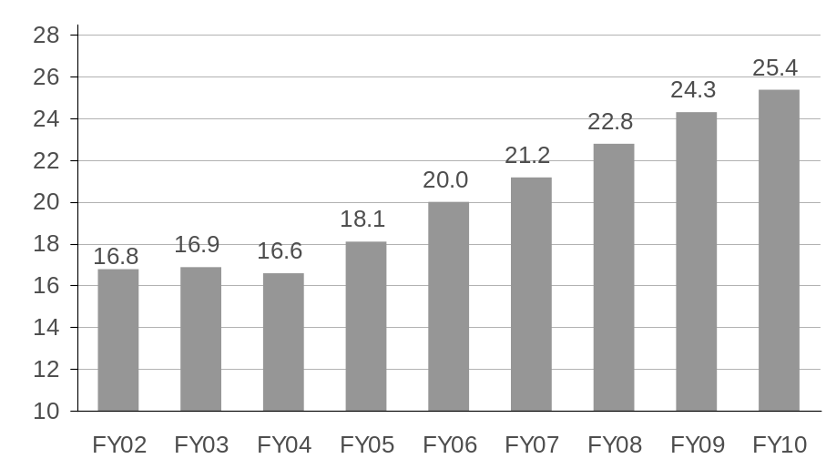
ECONOMY | Tiger Economy
Rising Investment Rates Driven by Strong Demand
Investment to GDP (%)
Unemployment rate (%)
8.5
8.27
8.27
8.0
7.82
7.69
7.69
7.5
7.0
6.7
6.5
2001
2002
2003
2004
2005
2006
Source: Ministry of Finance
Source: Economic Survey 2005-06
Steadily rising investment levels and capital formation
Cheap human capital, underdeveloped demand and rising incomes tapped
Source: BMA Capital, 2007

Slide 16
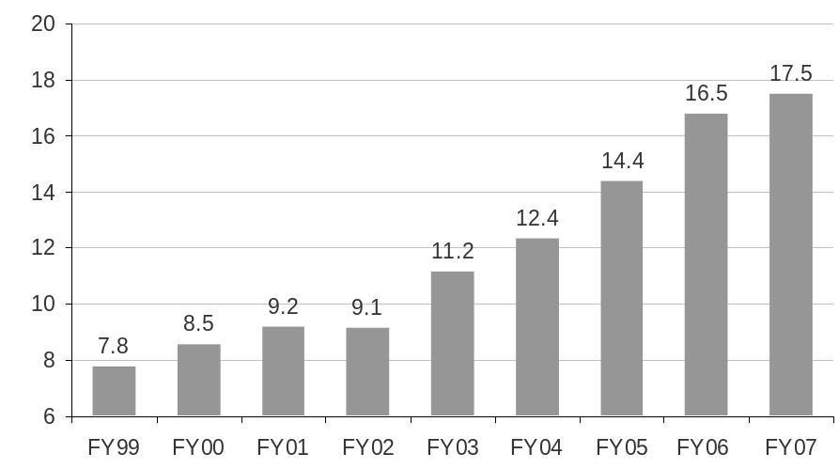
ECONOMY | Tiger Economy
Exports Doubled, Capacity Up
Exports (US$ bn)
Exports to GDP (%)
120%
106.1%
100%
80%
60%
45.2%
40%
36.2%
29.7%
20%
19.1%
12.1%
0%
Malaysia
Thailand
China
Indonesia
India
Pakistan
Source: Federal Bureau of Statistics
Source: Economic Survey 2005-06
Exports have doubled in the last 5 years despite recent easing
Exports will lead real GDP growth through enhanced capacity as costs ease
Source: BMA Capital, 2007

Slide 17
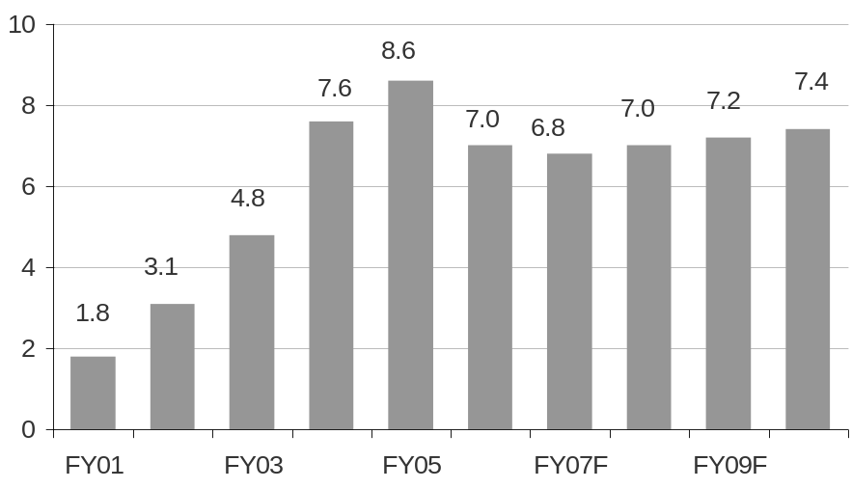
ECONOMY | Tiger Economy
Sustainable Economic Growth Generated
Real GDP Growth (%)
GDP Per Capita (US$)
USD
1400
1200
US$1000
crossed!
1000
800
600
400
FY01
FY03
FY05
FY07
FY09
Source: Economic Survey 2004-05, 2005-06
Source: Economic Survey 2004-05, 2005-06
* At current dollar prices
Real GDP has grown at 7.0% for the last 3 years and the accelerated trajectory is
sustainable
Per capita income will cross US$1,000 with in 2 years – and US$2,000 BY 2014
Source: BMA Capital, 2007

Slide 18
ECONOMY | Tiger Economy
Government Reform has Revitalized Economic Performance
Fiscal Responsibility & Debt Limitation Act
Consistency & Continuity In Policies
Tax Reforms
Major
Economic
Reforms
Fiscal Transparency
Governance
Reforms
Capital Market Reforms
Agriculture Sector Reforms
Financial Sector
Reforms
Industry &
Investment Reforms
Deregulation, liberalisation
&
Privatisation
Source: BMA Capital, 2007

Slide 19

IT SUCCESS STORIES | World class intellectual property & operations
Over 1,000 active IT companies
Two Billion Dollars Industry including one billion dollars exports
World Leader in Quality with over 125 ISO and CMM certified companies.
100,000 IT professionals in country including several thousand expatriates from North America and Europe with world class exposure and expertise
Large public R&D infrastructure employing over 10,000 IT professionals in Defence and other areas
Microsoft Local Software Economy (LSE) Partnership Framework – first country in the world
Tightening Intellectual Property Protection
Source: PSEB, 2007

Slide 20



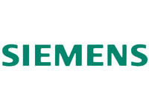



IT SUCCESS STORIES | World class intellectual property & operations
MNC Development Centers

Slide 21
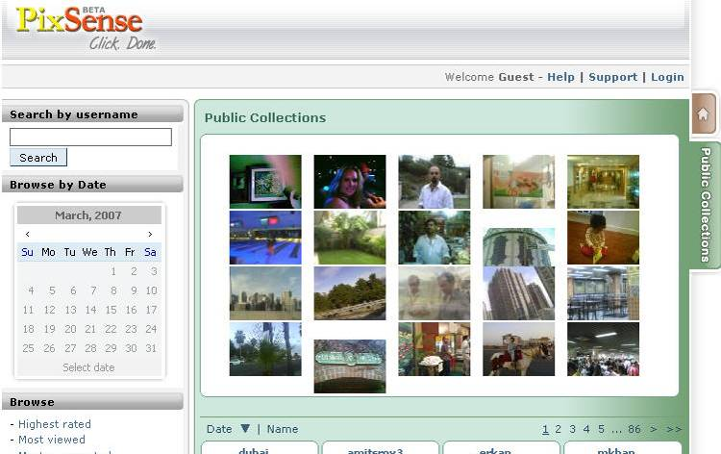
IT SUCCESS STORIES | World class intellectual property & operations
PixSense: Multimedia convergence solutions for wireless carriers

Slide 22
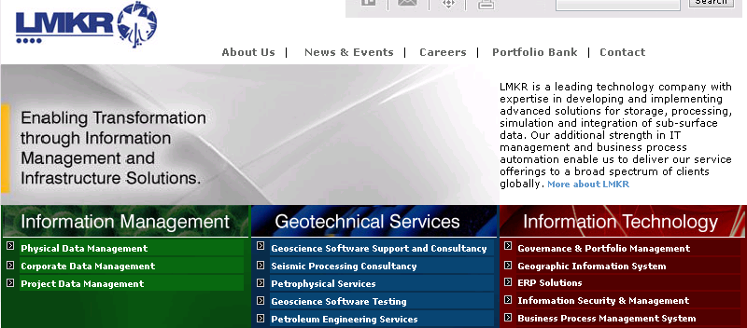
IT SUCCESS STORIES | World class intellectual property & operations
LMKR: Geological & Seismological data management

Slide 23
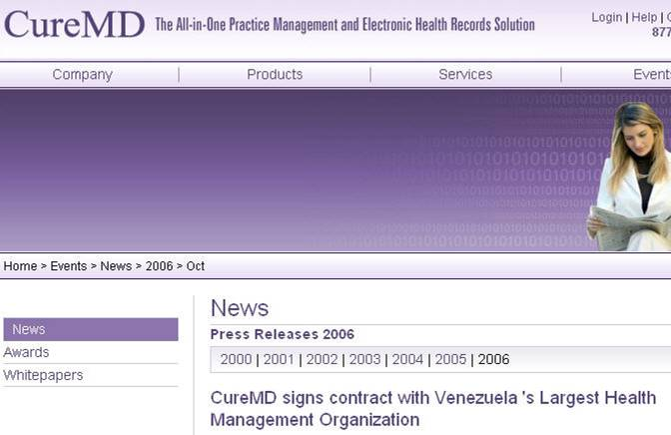
IT SUCCESS STORIES | World class intellectual property & operations
Cure MD: Leading web based HIPAA complaint healthcare system

Slide 24
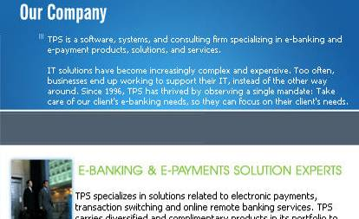
IT SUCCESS STORIES | World class intellectual property & operations
TPS Online: e-banking and e-payment products, solutions, and services

Slide 25
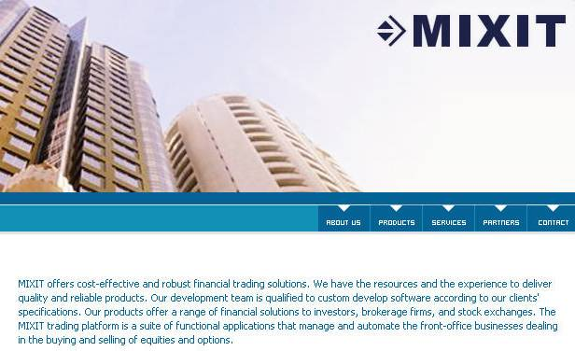
IT SUCCESS STORIES | World class intellectual property & operations
MIXIT: Stock Market Order Management, Running in NYSE
Half Billion $ daily transactions

Slide 26

IT SUCCESS STORIES | World class intellectual property & operations
Ultimus: Business Process Management, 160 international customers including Microsoft & White House

Slide 27

IT SUCCESS STORIES | World class intellectual property & operations
Scrybe: Leading Web based personal productivity and calendaring solution

Slide 28
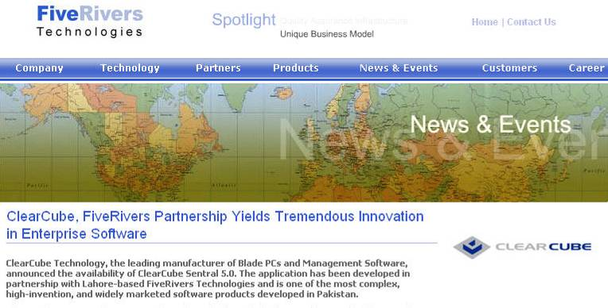
IT SUCCESS STORIES | World class intellectual property & operations
FiveRivers Technologies: world leader in fast growing field of centralized computing

Slide 29
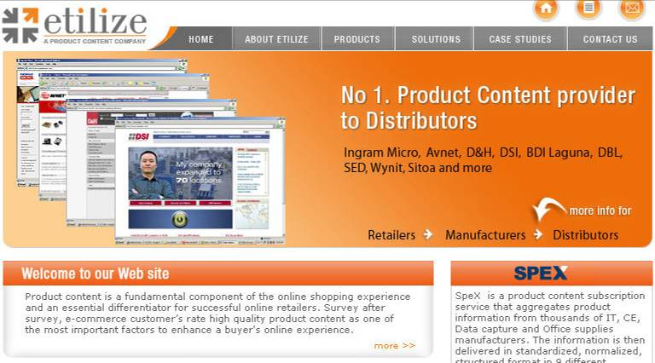
IT SUCCESS STORIES | World class intellectual property & operations
Etilize: serving 200 Fortune 500 companies

Slide 30

IT SUCCESS STORIES | World class intellectual property & operations
Mobile Complete: mobile testing solutions

Slide 31
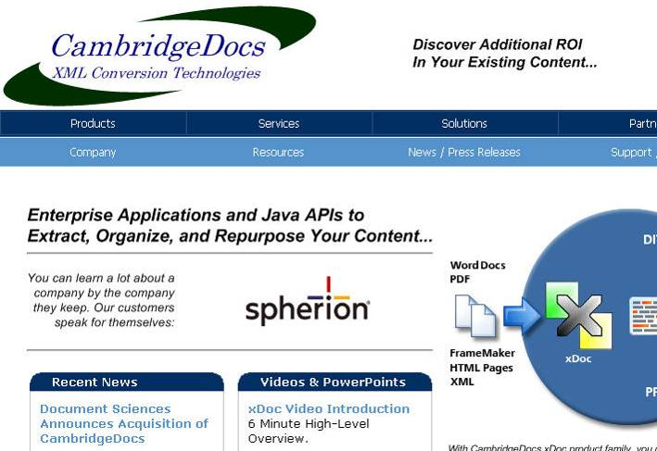
IT SUCCESS STORIES | World class intellectual property & operations
Cambridge Docs: document management solutions

Slide 32
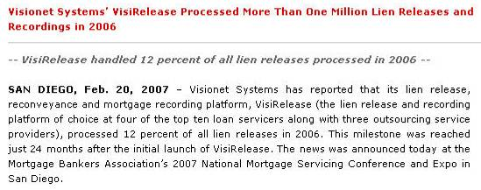

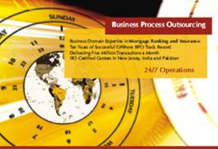
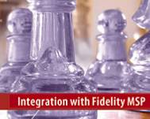
IT SUCCESS STORIES | World class intellectual property & operations
Visionet Systems: Lien release & mortgage recording platform

Slide 33


IT SUCCESS STORIES | World class intellectual property & operations
AniVista Studios: 3D Animation & Graphics

Slide 34
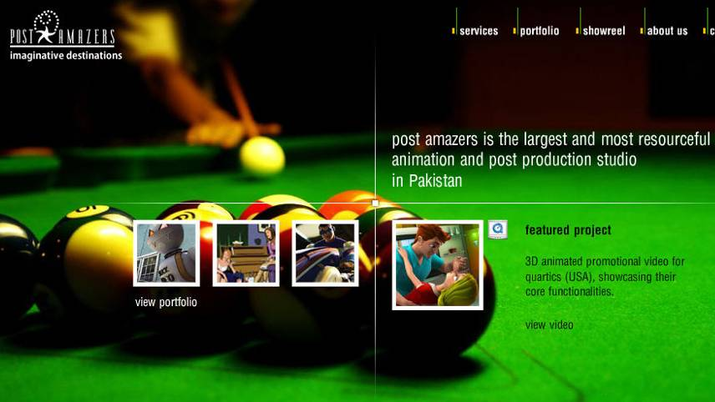
IT SUCCESS STORIES | World class intellectual property & operations
Post Amazers- Animation: “Son of Mask” and “Exorcist : The Sequel”

Slide 35
















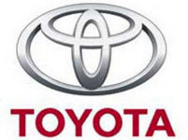




IT SUCCESS STORIES | World class intellectual property & operations
PROJECTS AWARDED BY MNC’s TO PAKISTANI COMPANIES
Data Warehousing
Car Leasing
Geological & Seismological Data Management
Custom Software Development

Slide 36
COSTS | Significantly less than competitors
US$ Cost per FTE
USA
India
Pakistan
(Full Time Employee)
Personnel
42,927
6,179
4,500
G&A Expense
8,571
1,000
800
Telecom
1,500
2,328
2,000
Property Rentals
2,600
847
700
Depreciation
3,000
1,500
1,000
Total Expenses
58,598
11,854
9,000
Exchange Rate
Change
0%
1.1%
1%
Total Price in
Market
58,598
13039
9000
India is 45% more expensive than Pakistan
Source: The Buying Triangle, LLC, 2006

Slide 37
TESTIMONIALS
“Pakistan a viable destination for BPO”
Lehman Brothers Pakistan IT Industry Report,
2006
Pakistan as a rising star offers a surprising new
home in South East Asia for Outsourced Customer
Management“ IDC, USA from the Report Pakistan
as Rising Star, July 2006
With fiscal and monetary stabilization policies, a
privatization plan and benefiting from firm
international support the economy has witnessed an
upswing not seen since the early 1960s or mid-
1970s. Pakistan Arrives, UBS Warburg, 2006
“Pakistan’s policymakers have in the past few years
created an environment within which the private
sector has begun to thrive.” Country Report,
Pakistan –Report by The Economist Intelligence
Unit, March 2007
“With a great number of countries still going through
a tightening of money supply, Pakistan appears well
placed with tight monetary policy likely to ease later
this year.” Pakistan: Just Push Play –Report by
JP Morgan, January 2007
“This is the only country in Asia where foreigners
can own 100% of any asset in any sector, and they
have been buying a lot.” The Gross Prophet –
Report by Merrill Lynch, March 2007
“Despite adversities in domestic politics, foreign
private investment has risen 147% year on year and
continues to be a dominant feature over the last
three months. This reflects investors’ confidence on
Pakistan’s future economic growth prospects.” On
the Investors Radar Screen –Report by Merrill
Lynch, April 2007

